Slide 1
Question Bank & Library for the Department of CSE
SUBMITTED BY:
SUBMITTED T0:

Slide 2


What is Question Bank?
A question bank is a planned library of test item designed to fulfill certain predetermined purpose.

Slide 3
Motivation
Question bank makes available statistically sound question of known technical worth and model question papers and thus facilitates selection of proper question of a well designed to question papers.
The library segment helps to find the reference books easily as we are used to read pdf version.
From the resource segment student get easy access for research papers. They need not to go anywhere.

Slide 4
Purpose
To improve the learning process
It gives you the idea about the type of questions
It is important to revise your entire syllabus quickly
Give a general idea of the upcoming paper.

Slide 5

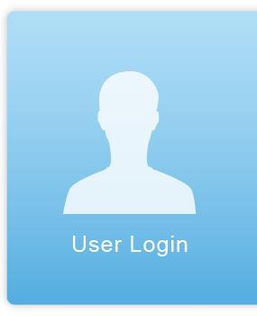


Features
Login Segment
Create account
Sign in to your account
Question segment
Can Upload questions
Can download questions
Library segment
Books of different courses can be downloaded
Books of different courses can be uploaded

Slide 6



Contd..
Resources
Can upload research papers
Can download research papers
Home page
Information about UAP
Notification
Notify users about update

Slide 7
3.1 : Login system
Create account
Sign in to your account
It is defined as teachers students & admin going to use it. So to differ their role we use this feature.

Slide 8
3.2 : Question Archive
This segment contains of questions
Questions can be uploaded
Questions can be downloaded from here

Slide 9
3.3: Library
Here all books from different semesters are stored.
Books (pdf) can be uploaded
Books can be downloaded

Slide 10
3.4: Resources
Papers included conference, research, journal of faculties and students are stored here
So papers are uploaded by the teachers
Papers are visible to all students they can download those papers.

Slide 11
3.5:Home page
It include some basic information of the University

Slide 12
3.6: Notification
We will try make a notification system for the resource that actually helps the user to get notify about the update resources.

Slide 13




IDE:
Technology
Framework:
Database:
Language:

Slide 14
UI Design

Slide 15
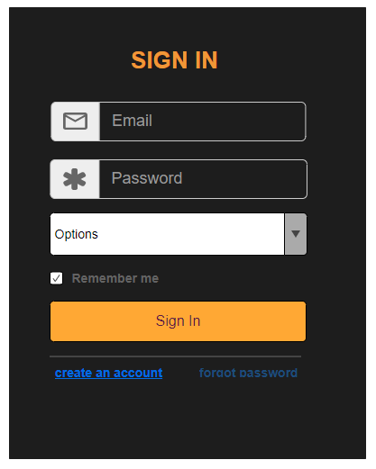
Log in page
Moqups.com

Slide 16
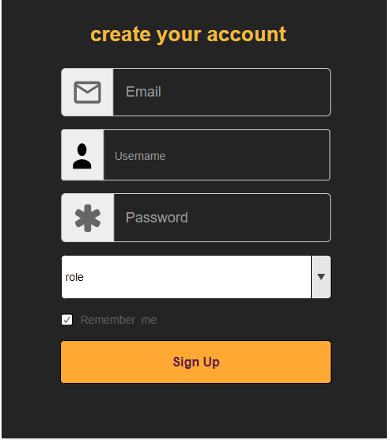
Create Account

Slide 17
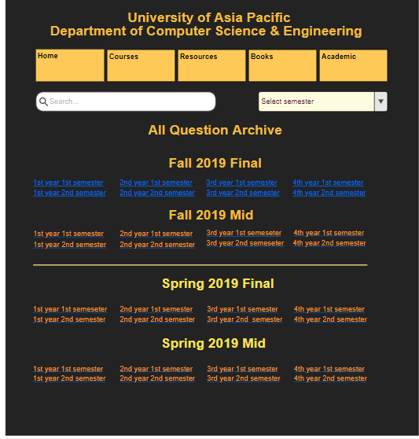
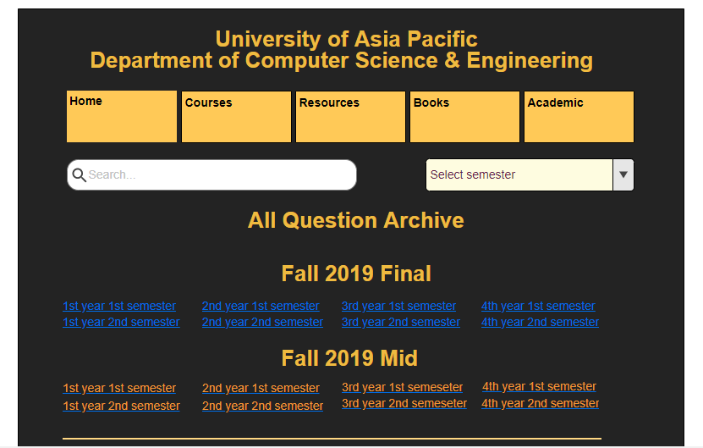
Homepage
Upload
Upload

Slide 18
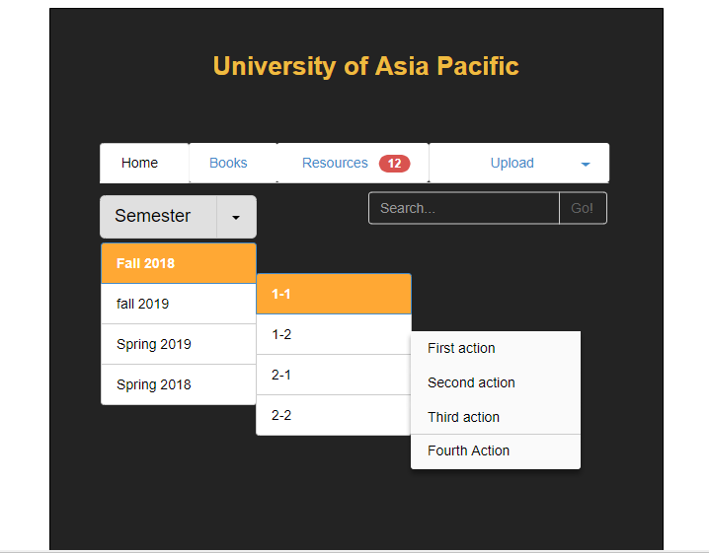
Process for both Question and Books
Fall 2019
Spring 2019……
Semester year
Select Semester
1-1
1-2…….
Select Course
CSE 401
CSE 402…

Slide 19
Upload

Slide 20

Timeline
Week 1
Planning
Week 2
Research
Feasibility study
UI design
Week 3 & 4
Analysis & Study
Week 5 & 6
development
Week 12 -13
Documentation
& Submission
Week 11
Testing (customer acceptance)
Week 9 - 10
development of Database
Week 7 - 10
Implementation

Slide 21
Conclusion:
We hope the application will help the student to save their time and provide an easier way for collecting questions, slides and books from an organized system. Some of them can contribute to the system by working as an admin and help other students too.

Slide 22
Thank You
Any Question?

